Slide 1
Virtual Sports Day 2020

Slide 2
Welcome to Blaise High School Virtual Sports Day 2020!
The PE department have put together a Virtual Sports Day for teachers and students to take part in at home!
You will be competing against all the other tutor groups to see who will be crowned winners of Blaise High School Sports Day 2020!
There are 5 challenges for you to take part in. Each slide will show a different challenge that will require little or no equipment. All are really easy so everyone can take part!
If you only want to take part in some challenges and not all then that is fine but just remember more challenges = more points!
Once you have completed the challenge, Complete the Exit Form. Fill out the information, enter your score and submit the form.
The PE department will be keeping track of scores and adding up points. There will be winners for individual events in each year group, Overall tutor group in each year group and overall tutor group in the school.

Slide 3
Welcome to Blaise High School Virtual Sports Day 2020!
You have the whole week to complete 5 challenges and upload your scores. There is no time limit for when you need to complete each challenge as long as they are all done and submitted by 6pm on Sunday 5th July 2020.
We advise that you complete all the challenges first and then upload your scores at the end.
For each challenge you need to make sure that you complete the challenge fairly. Have someone count the number of times you complete each movement and act as a judge to ensure that it is fair. Any results that are way above the average will not be counted.
Honesty is key!

Slide 4
Before you begin.
It is really important you do the following before you take part:
A warm up – You have all been taught the importance of warming up in PE.
Make sure it includes a pulse raiser and stretches to warm your joints and muscles!
Check the environment around you
Do you have enough space?
Do you need to clear some things away to make the space safer?
Are there any wires/objects you could trip over?
Make sure you are wearing sensible footwear - We advise you wear trainers to protect your feet and give you the most grip!

Slide 5
The Events
1- Target challenge- Socks in a basket
2- Endurance challenge- How long can you hold a plank?
3- Dance challenge- In twists in 1 min
4- Speed challenge- Mountain Climbers in 1 min
5- Coordination challenge.- Juggling

Slide 6
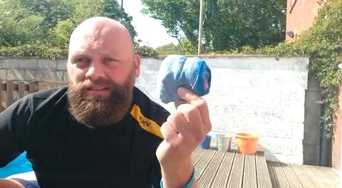
Challenge Card 1- Target Challenge
Socks in a Basket-
Space- 3m space inside or outside
Equipment- Box/ Containers, balled up socks, tape measure
Rules- Measure 3m away from your boxes or baskets. Hold your balled up socks. Time 1 minute and count how many points you can get the socks by getting the socks into the box.
Small- 1 point, Medium- 2 points Large- 3 points

Slide 7
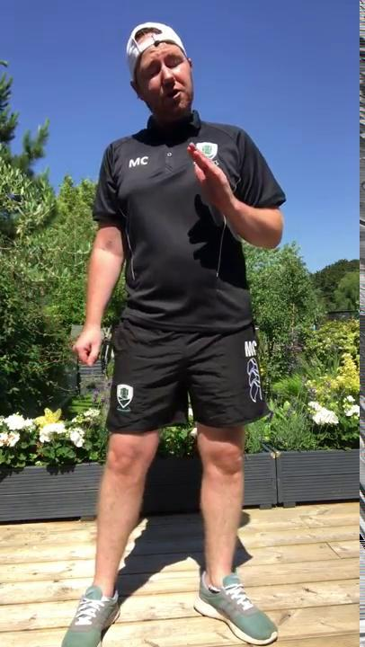
Challenge Card 2-Muscular endurance Challenge
Plank Challenge-
Space- Big enough for you to lie down
Equipment- You and a timer
Rules- Hold the plank position on your forearms for as long as you can. Start in the plank position and start the timer, end the timer when you drop to the floor

Slide 8
Challenge Card 3- Dance Challenge
The In Twist -
Space- Enough space for you to stand in and turn your leg to the side.
Equipment- You and a timer
Rules- You have one minute to complete as many “In twists” as you can. Watch Miss Harper demonstrate the move and have a few practices to get used to it. Then you have one minute to do as many as you can.

Slide 9
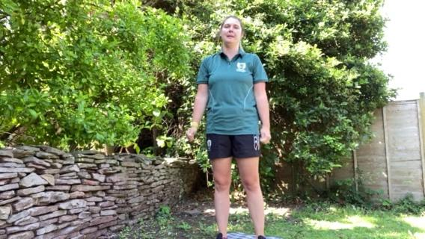
Challenge Card 4- Speed Challenge
Mountain Climbers in 1 minute-
Space- Big enough for you to lie down in a press up position.
Equipment- You, Timer
Rules- Start in the press up position with left leg pulled into your chest and the other leg out straight. Start the timer and swap your legs in and out. Your right leg must go in and out for 1 movement to count.

Slide 10
Challenge Card 5-Coordination Challenge
Juggling- (This is relaxing and great fun once you can do it.)
Space- Enough to stand up in
Equipment- Three balled up pairs of socks or fruit (you can eat after). A partner and a timer.
Rules- Get you partner to start timing as soon as you throw the first ball (sock/orange) and stop timing when you drop a ball (sock/orange). Then check your score against challenge 5.
How to juggle video lesson starts at 50 seconds.
https://www.youtube.com/watch?v=JZmmOdnljG4&authuser=0

Slide 11
Point Scoring
You can score individually for each event or add up your points for an overall 5 event score.
 | Bronze (3 Points) | Silver (5 Points) | Gold (8 Points)
1- Target | 2-10 | 11-24 | 25+
2- Muscular Endurance | 10-39 seconds | 40-59 seconds | 1 minute +
3- Dance | 5-10 | 11-20 | 21+
4- Speed | 10-30 | 31-50 | 51+
5- Coordination | 2-10 Seconds | 11-24 Seconds | 25+ Seconds
Total Overall 5 Events | 15- 24 points | 25-39 points | 40 Points

Slide 12
May the best tutor group win
Good luck,
We hope you enjoy the challenges and have some fun!
From the PE Team

