Slide 1
Units and prefixes
Mathematics for A-level Science

Slide 2
Why are units and prefixes important?
One of reasons we use the international system of units is because it makes the conversion of units (especially those with different prefixes) mathematically simple.
We use prefixes as shorthand for standard form when using commonly occurring very large or very small numbers.
This makes it easier to discuss and talk about sets of these numbers.
For example, the length 0.0000000023 m may be written as 2.3 × 10^{–9} m
2.3 is the digit number and is kept. 10^{–9} is known as the exponential number and can be replaced with the prefix ‘n’ pronounced as ‘nano’.
Hence
0.0000000023 m = 2.3 × 10^{–9} m = 2.3 nm

Slide 3
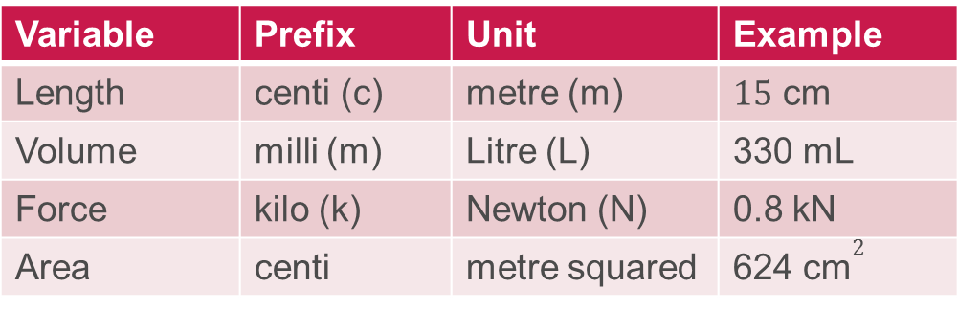
Why are units important?
When measuring a variable in science we must consider the best unit (and prefix) to use. This often differs depending on the subject.
Variable | Prefix | Unit | Example
Length | centi (c) | metre (m) | 15 cm
Volume | milli (m) | Litre (L) | 330 mL
Force | kilo (k) | Newton (N) | 0.8 kN
Area | centi | metre squared | 624 ${\text{cm}}^{\text{2}}$
Version 3.0

Slide 4
Prefixes
Here are the common unit prefixes you are likely to encounter:
Number |  | Exponential number | Prefix
billion | 1 000 000 000 | 10⁹ | G | ‘giga’
million | 1 000 000 | 10⁶ | M | ‘mega’
thousand | 1000 | 10³ | k | ‘kilo’
tenth | 0.1 | 10^{–1} | d | ‘deci’
hundredth | 0.01 | 10^{–2} | c | ‘centi’
thousandth | 0.001 | 10^{–3} | m | ‘milli’
millionth | 0.000 000 1 | 10^{–6} | μ | ‘micro’
billionth | 0.000 000 000 1 | 10^{–9} | n | ‘nano’

Slide 5
Examples
Example 1
The length of a DNA nucleotide is 0.6 nm.
Convert this number into standard form.
b) If a strand of DNA is 1.6 m long, how many nucleotides is it made up of?

Slide 6
Examples
Example 1
The length of a DNA nucleotide is 0.6 nm.
Convert this number into standard form.
0.6 nm = 0.6 × 10^{–9} m
b) If a strand of DNA is 1.6 m long, how many nucleotides is it made up of?

Slide 7
Examples
Example 1
The length of a DNA nucleotide is 0.6 nm.
Convert this number into standard form.
0.6 nm = 0.6 × 10^{–9} m
b) If a strand of DNA is 1.6 m long, how many nucleotides is it made up of?
1.8 m / 0.6 nm = 1.8 m / (0.6 × 10^{–9} m) = 3 × 10⁹ = 3 billion

Slide 8
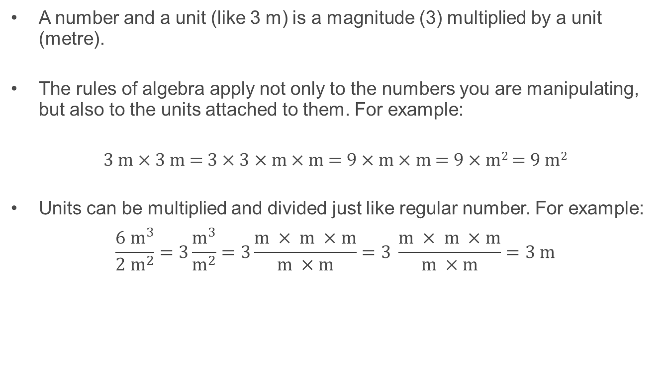
Manipulating units
A number and a unit (like 3 m) is a magnitude (3) multiplied by a unit (metre).
The rules of algebra apply not only to the numbers you are manipulating, but also to the units attached to them. For example:
3 m × 3 m = 3 × 3 × m × m = 9 × m × m = 9 × m² = 9 m²
Units can be multiplied and divided just like regular number. For example:
$$\frac{{6 m}^{3}}{2 m^{2}}=3\frac{m^{3}}{m^{2}}=3\frac{m × m ×m}{m ×m}=3 \frac{m × m ×m}{m ×m}=3 m$$

Slide 9
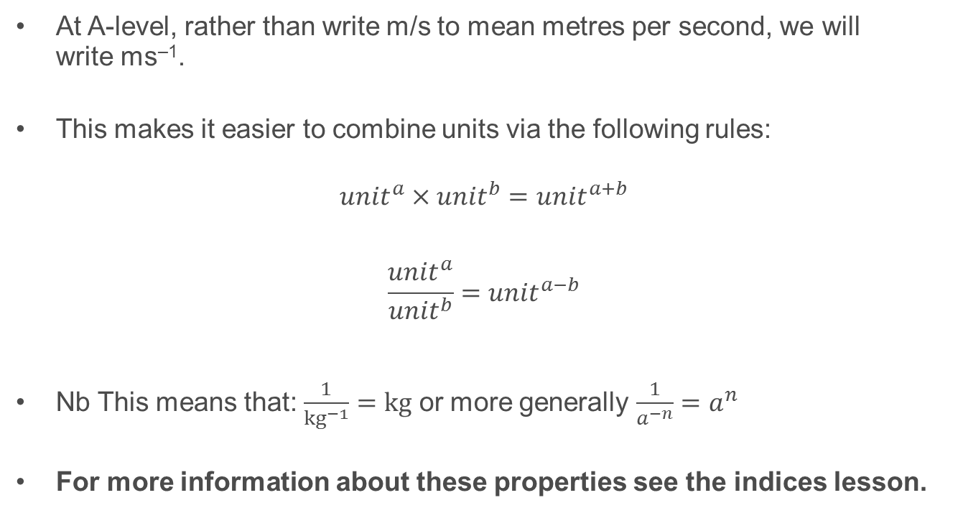
Manipulating units
At A-level, rather than write m/s to mean metres per second, we will write ms^{–1}.
This makes it easier to combine units via the following rules:
$${unit}^{a}×{unit}^{b}={unit}^{a+b}$$
$$\frac{{unit}^{a}}{{unit}^{b}}={unit}^{a−b}$$
Nb This means that: $\frac{1}{{kg}^{−1}}=kg$ or more generally $\frac{1}{a^{−n}}=a^{n}$
For more information about these properties see the indices lesson.

Slide 10
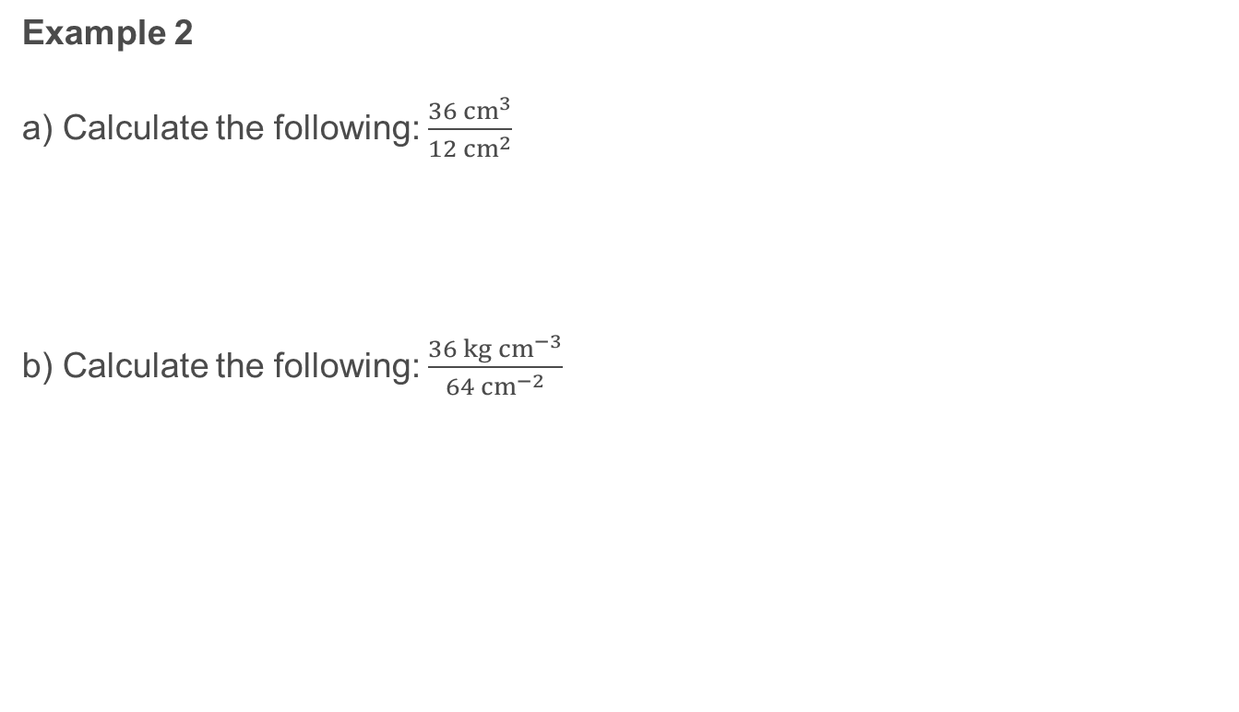
Examples
Example 2
a) Calculate the following: $\frac{36{ cm}^{3}}{12{ cm}^{2}}$
b) Calculate the following: $\frac{36 {kg cm}^{−3}}{64 {cm}^{−2}}$

Slide 11
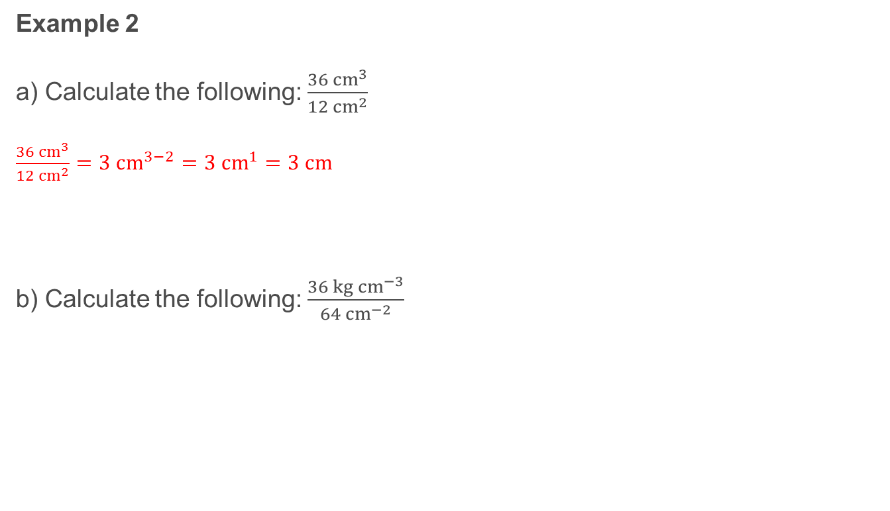
Examples
Example 2
a) Calculate the following: $\frac{36{ cm}^{3}}{12{ cm}^{2}}$
$\frac{36{ cm}^{3}}{12{ cm}^{2}}=3 {cm}^{3−2}=3{ cm}^{1}=3 cm$
b) Calculate the following: $\frac{36 {kg cm}^{−3}}{64 {cm}^{−2}}$

Slide 12
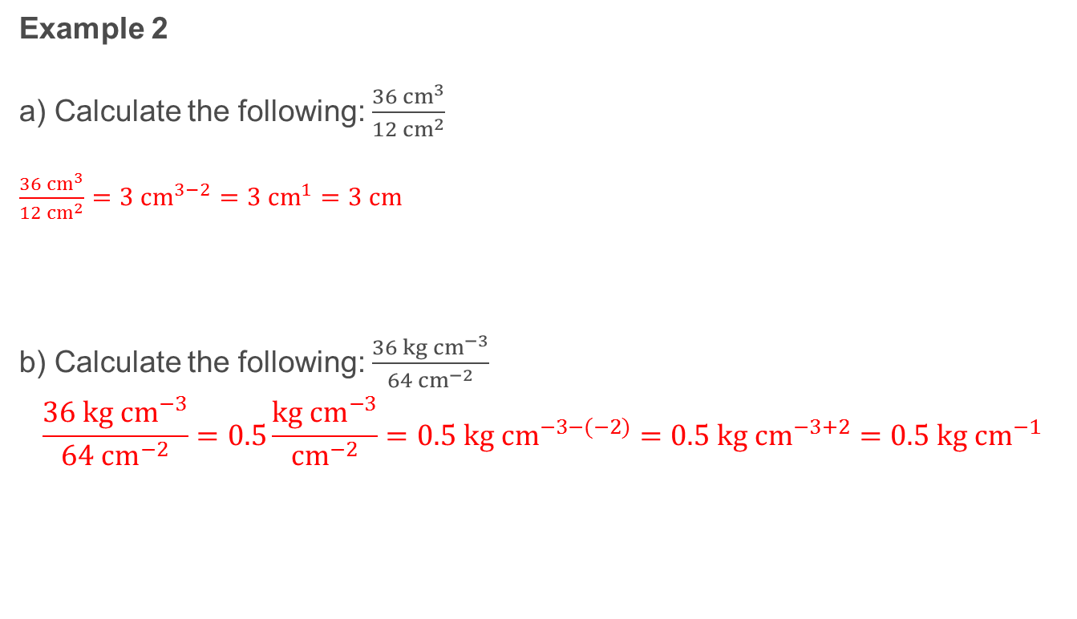
Examples
Example 2
a) Calculate the following: $\frac{36{ cm}^{3}}{12{ cm}^{2}}$
$\frac{36{ cm}^{3}}{12{ cm}^{2}}=3 {cm}^{3−2}=3{ cm}^{1}=3 cm$
b) Calculate the following: $\frac{36 {kg cm}^{−3}}{{64 cm}^{−2}}$
$$\frac{36 {kg cm}^{−3}}{{64 cm}^{−2}}=0.5\frac{{kg cm}^{−3}}{{cm}^{−2}}=0.5 kg {cm}^{−3−(−2)}=0.5 kg {cm}^{−3+2}=0.5 kg {cm}^{−1}$$

Slide 13
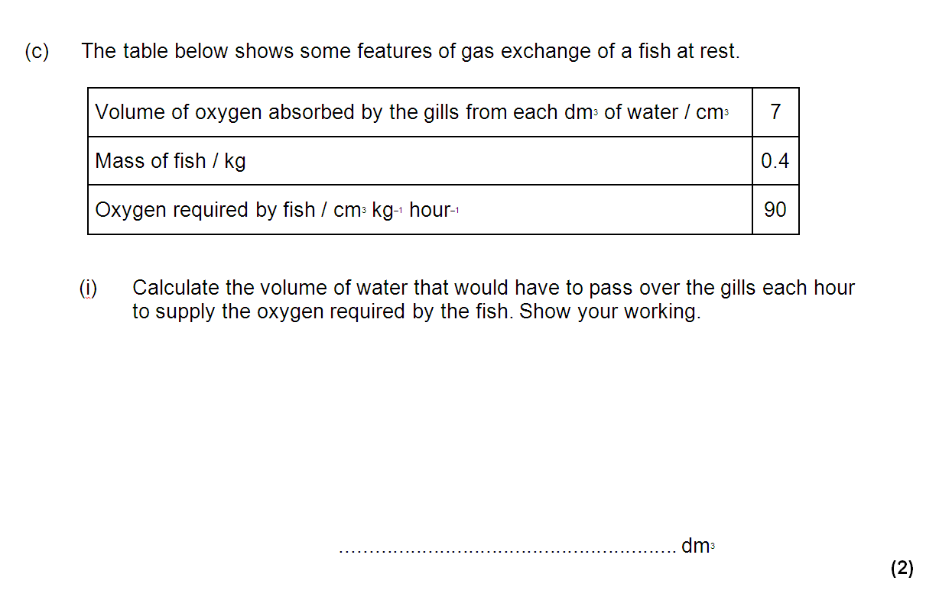
Exam paper: Example

Slide 14
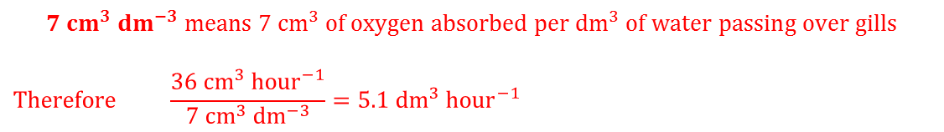
Exam paper: Example 1
$$90 {cm}^{3}{ kg}^{−1} {hour}^{−1} means 90 {cm}^{3} of oxygen required per kg per hour. Therefore,$$
$$90 {cm}^{3}{ kg}^{−1} {hour}^{−1}×0.4 kg=36{ cm}^{3} {hour}^{−1} of oxygen required$$
$$7 {cm}^{3} {dm}^{−3} means 7 {cm}^{3} of oxygen absorbed per {dm}^{3} of water passing over gills$$
$$Therefore \frac{36{ cm}^{3} {hour}^{−1}}{7 {cm}^{3} {dm}^{−3}}=5.1 {dm}^{3} {hour}^{−1}$$
Notes:
When we multiply 90 by 0.4 the kg and ‘per kg’ cancel out leaving a volume of oxygen required for the specific mass of the fish.
7 cm^3 per dm^3 looks complex mathematically, but it just details the volume of absorbable oxygen in every dm^3 of water. When we divide 36 by 7 the cm^3 and the cm^3 cancel each other out, leaving units of dm^3 per hour. (Remember 1/(x^-1) = x)
As the question asks for the oxygen required in one hour our answer becomes 1 x 5.1 dm^3 hour^-1 = 5.1 dm^3.

