Slide 1

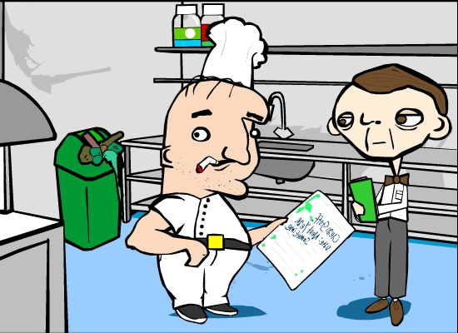
Unit 1: Food Safety
LO4: Know how food can cause ill health.
AC4.2: Describe the role and responsibilities of the
Environmental Health Officer (EHO)
CRITERIA
You must know:
Role
Enforcing environmental health laws
You must know:
Responsibilities
Inspecting business for food safety standards
Follow up complaints
Follow up outbreaks of food poisoning
Collecting samples for testing
Giving evidence in prosecutions
Maintaining evidence
Submitting reports

Slide 2
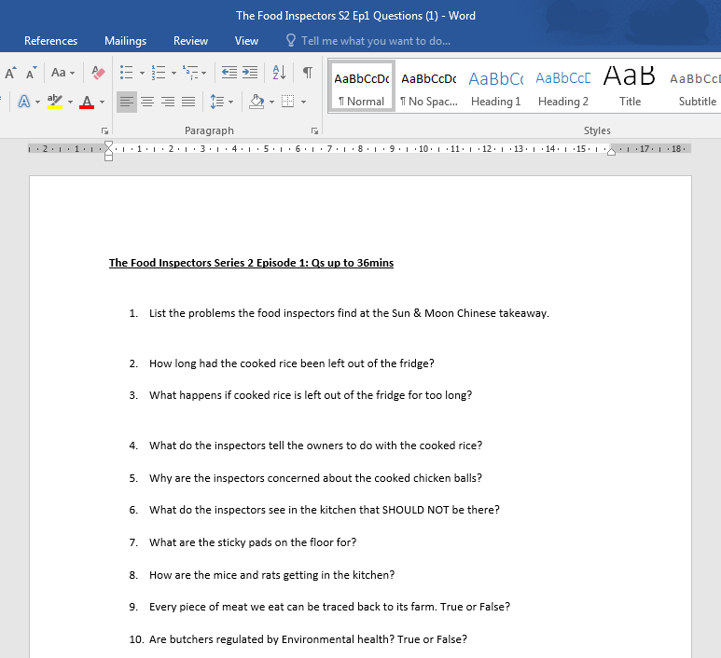

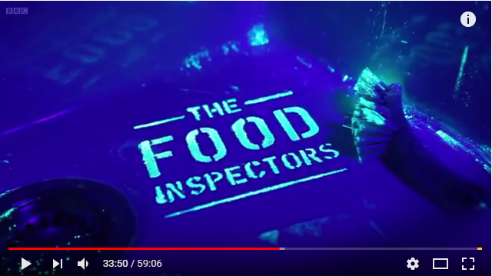
Unit 1: Food Safety
LO4: Know how food can cause ill health.
AC4.2: Describe the role and responsibilities of the
Environmental Health Officer (EHO)
DEMO
TASK: Watch The Food Inspectors Series 2 Ep 1.
Complete the question sheet while you watch.
BBC ONE: The Food Inspectors
Enfield Council's food inspectors Mary and Claire visit a Chinese takeaway, where they discover
a rabbit which belongs to the owner's daughter
and is being kept in a food preparation area.
They also find an area awash with mouse
droppings and urine, and in an outside storage shed there are the remains of a dead rat or mouse!

Slide 3
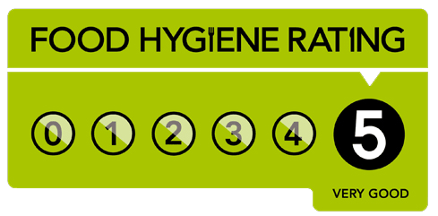
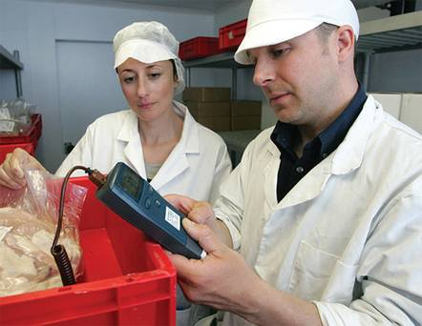
Unit 1: Food Safety
LO4: Know how food can cause ill health.
AC4.2: Describe the role and responsibilities of the
Environmental Health Officer (EHO)
SHARE
The EHO
At the end of their visit, in England, Wales, and Northern Ireland, they will present the establishment with a score from the
Food Hygiene Rating scheme of 0 – 5. The scheme is standardised across England and Wales to maintain a consistent assessment of safety standards. Any business should be able to achieve a “5 – very good” rating.
Scotland has its own equivalent system but will either issue
a “pass” or “improvement required” rating.
If an establishment is perceived as high risk, officers will inspect it every 6 months. If it is low risk, EHO officers may visit every 5 years. The risk depends on the type of business (for example, restaurants are higher risk than a shop selling packaged food), and the level of concern a business has caused from past inspections.
If a business prepares or serves food it must be registered it using either the food business registration service on GOV.UK or via the local authority website.
The Environmental Health Officer’s (EHO) role is to inspect premises in order to ensure the food a establishment produces is safe to eat.

Slide 4
Unit 1: Food Safety
LO4: Know how food can cause ill health.
AC4.2: Describe the role and responsibilities of the
Environmental Health Officer (EHO)
DEMO
The EHO
The Environmental Health Officer enforces hygiene,
health & safety legislation.
The E.H.O. has the authority to:
Issue a Prohibition Notice which means that the
catering establishment has to close until any problems have been rectified.
Issue an Improvement Notice which must be acted upon within a certain time limit.
Prosecute any person who does not comply with the Health & Safety at Work Act 1974 and
the Food Safety Act 1995
Food Safety Act 1995:
Keep yourself clean.
Keep the workplace clean.
Wear suitable clothing.
Protect food from contamination.
Store, prepare & serve food at the correct temperature.
Inform a manager if you are ill.
Do not work with food if you have symptoms of food poisoning.

Slide 5



Unit 1: Food Safety
LO4: Know how food can cause ill health.
AC4.3: Job Roles: Qualifications: EHO
SHARE
Environmental health officers make sure people's surroundings are safe, healthy and hygienic.
 | Salary £25,000 to £60,000 average per year |  | Hours 35-40 per week
1. Entry requirements
An environmental health degree or postgraduate degree approved by the Chartered Institute of Environmental Health (CIEH).
3. What you'll do
You could work for a local authority, the NHS or armed services, or a central government organisation like the Food Standards Agency.
Your day-to-day duties may include:
inspecting businesses for health and safety, food
hygiene and food standards
following up complaints and investigating outbreaks of food poisoning, infectious disease or pests
collecting samples for laboratory testing
enforcing environmental health laws
investigating accidents at work
advising community groups and giving educational talks
giving evidence in court
writing records and reports
advising employers on all environmental health matters
2. Skills required
You'll need:
excellent communication and negotiation skills
the ability to explain environmental health laws and procedures
the ability to work methodically
problem solving and time management skills
the ability to work with people from all backgrounds

