Slide 1
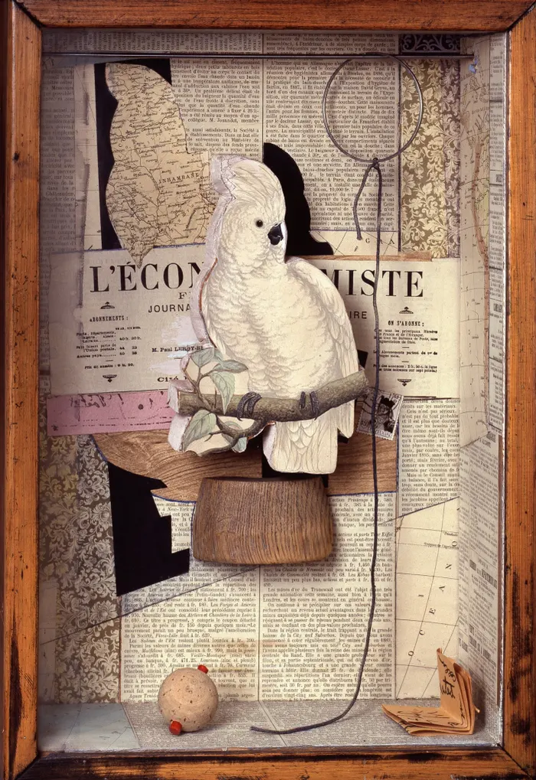
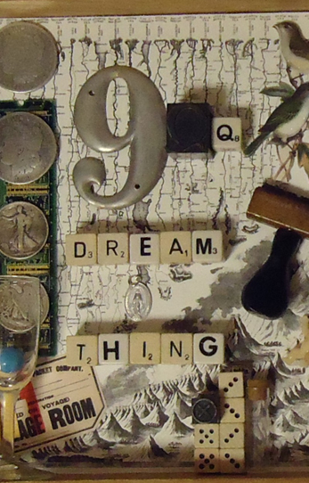

Project 1
Artist research based on Joseph Cornell
Identity in a box
Deadline 1st May
Research Joseph Cornell. He made boxes full of personal possessions, drawings and paintings symbolizing himself. He was confined at home and dreamed of travelling.
Complete a research page based on his work.
Copy some of his work as paintings and drawings rather than boxes.
You will need
Artist title
Annotation about his life
Annotation about the work in his boxes
Annotation about how his work would inspire your own box
Copies of his work

Slide 2
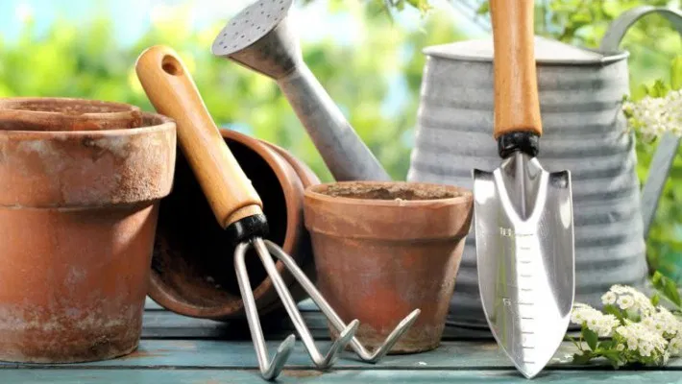
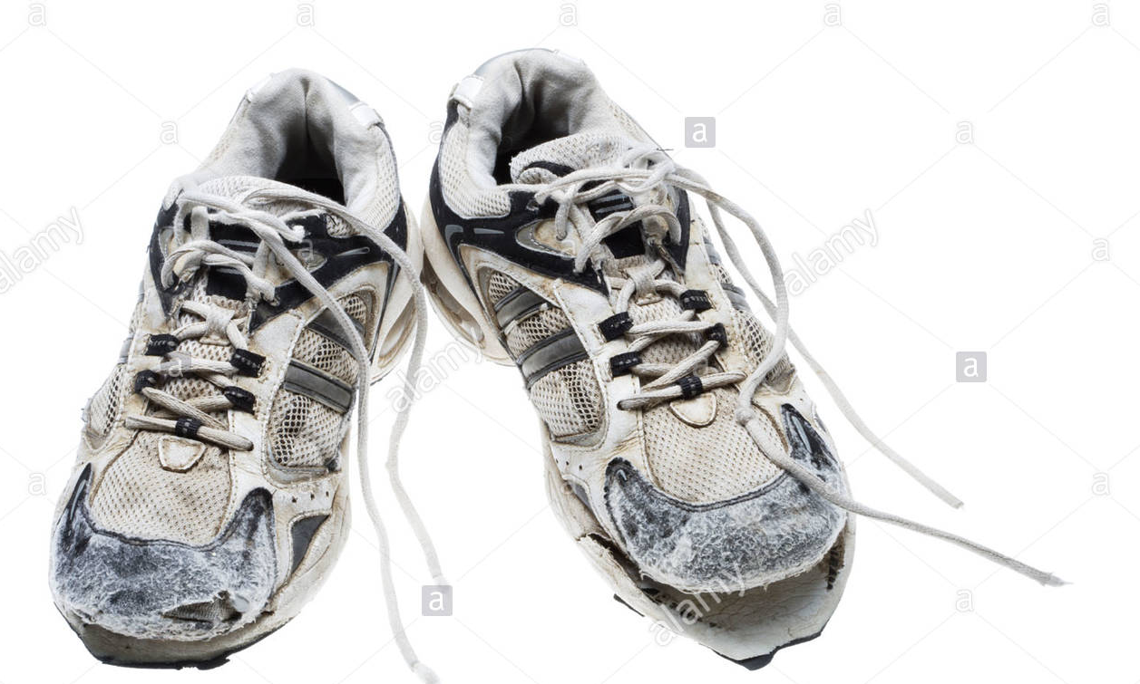
Project 2
Photo shoot
Deadline 7TH May
This work is linked with Joseph Cornell's work. He was confined at home at dreamed of travelling. He also painted and drew different images and objects in his life. You are currently in a lock down yourself what positive images could you take photographs of symbolizing your life at the moment.
These are some of the ideas I thought of:
Pair of trainers as I’m doing a lot more exercise than normal.
Photograph of my family walking
Picture of gardening tools .
What ideas could you photograph

Slide 3
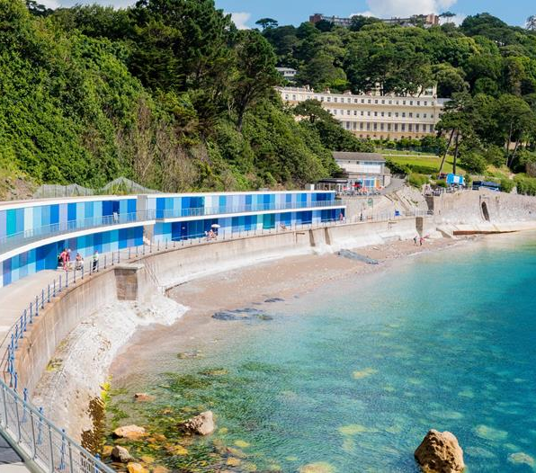
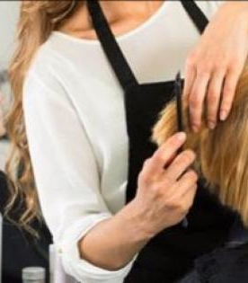
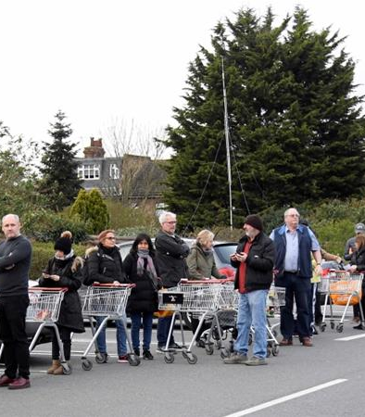
Project 3
Photo shoot
Deadline 15th May
Again linking with Joseph Cornell’s work he dreamed of travelling when he was confined at home. During the lockdown what have you missed how would you encapsulate that into a series of photographs.
Queuing up for a food shop.
Going to the beach
Seeing my Dad i.e. grandparents for you
Shopping
Hairdressers

Slide 4
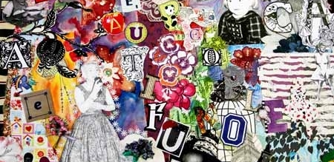
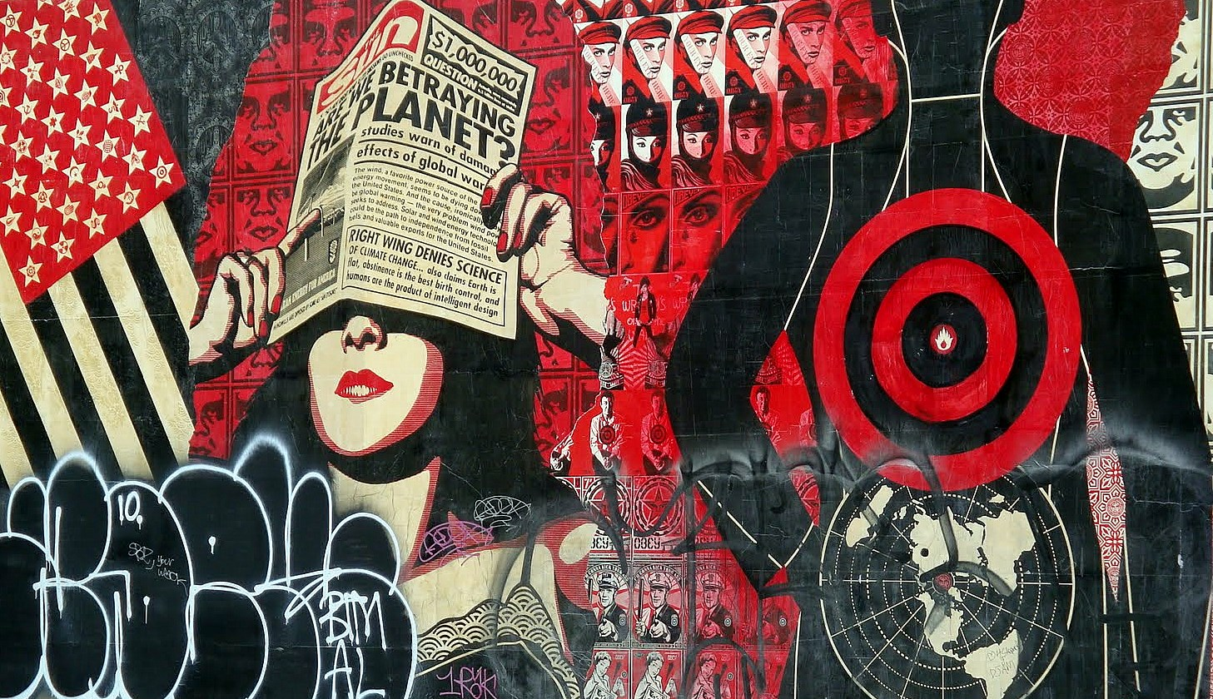
Project 4
Design a collage representing the lockdown
Deadline 22nd May
This collage can consist of
Newspaper articles, images and photos
Drawings , paintings
Photographs and drawings of your portrait showing expression.
Thinks about your colourways.
Use mixed media for this if possible

Slide 5
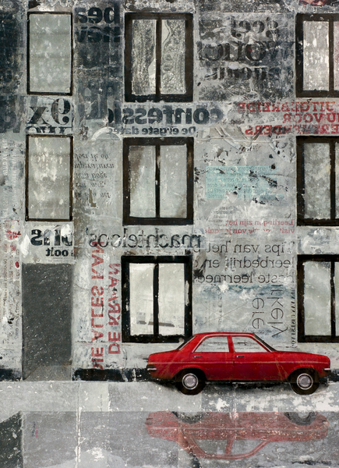
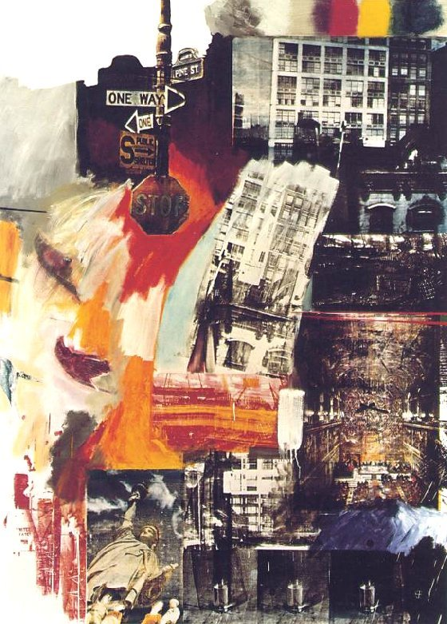
Project 5
Create your own mixed media work based on Cornell's work
Deadline 16th June
Using all the research you have currently completed.
Use project 4 as the background.
Develop your photographs into drawings to layer up the background.

